Slide 1
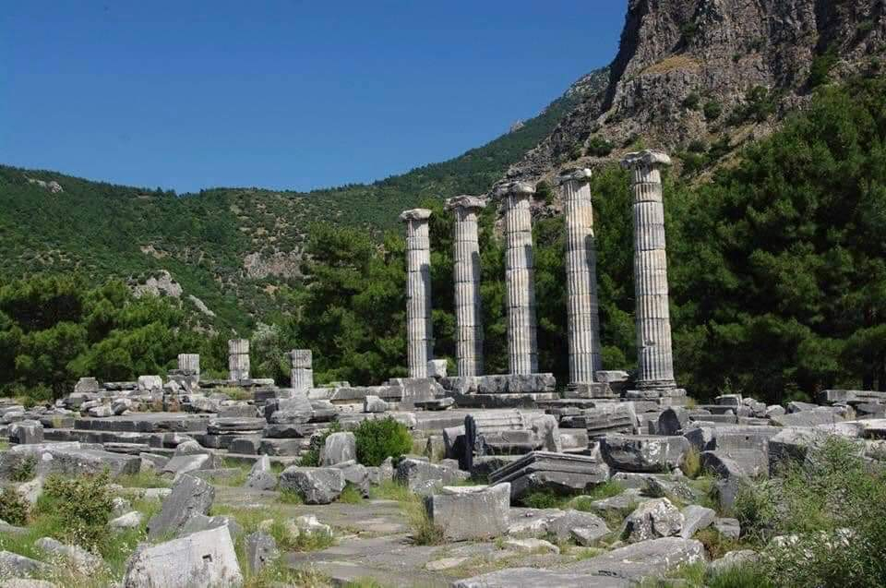
Hedgehog Rock

Slide 2

University of Science and Technology Bannu
Data Mining
Lesson 9
February 22, 2024

Slide 3
Learning Objectives
Association Rule Mining

Slide 4
Lesson outline
What is Association Rule and frequent pattern mining?
The Apriori Algorithm for Association Rule
How FP-Growth Algorithm Work in Association Rule?
Practical Implementation of the Apriori Algorithm.
Practical Implementation of FP-Growth Algorithm.

Slide 5

Frequent patterns and association rules
Imagine that you are a sales manager at AllElectronics
Primary responsibility “Sales Growth”
Customer purchased PC and Digital Camera
You are recommending new item to her/him
You can recommend a new item to her/him if you have a knowledge
Knowledge of “which products are frequently purchased by your customers following their purchases of a PC and a digital camera in sequence”
Frequent patterns and association rules are the knowledge that you want to mine in such a scenario.

Slide 6
FP-Growth
FP-growth, adopts a divide-and-conquer strategy as follows.
First, it compresses the database representing frequent items into a frequent pattern tree, or FP-tree, which retains the itemset association information.
It then divides the compressed database into a set of conditional, each associated with one frequent item or “pattern fragment,” and mines each database separately.
For each “pattern fragment,” only its associated data sets need to be examined.
Therefore, this approach may substantially reduce the size of the data sets to be searched, along with the “growth” of patterns being examined.

Slide 7
FP-Growth
The first scan of the database is the same as Apriori, which derives the set of frequent items (1-itemsets) and their support counts (frequencies).
Let the minimum support count be 2. The set of frequent items is sorted in the order of descending support count. This resulting set or list is denoted by L.
TID | List of items
T100 | I1, I2, I5
T200 | I2, I4
T300 | I2, I3
T400 | I1, I2, I4
T500 | I1, I3
T600 | I2, I3
T700 | I1, I3
T800 | I1, I2, I3, I5
T900 | I1, I2, I3
Item Id | Support Count | Node-Link
I2 | 7
I1 | 6
I3 | 6
I4 | 2
I5 | 2
L =

Slide 8
FP Tree construction process
An FP-tree is then constructed as follows.
First, create the root of the tree, labeled with “null.” Scan database D a second time. The items in each transaction are processed in L order (i.e., sorted according to descending support count), and a branch is created for each transaction. For example, the scan of the first transaction, “T100: I1, I2, I5,” which contains three items (I2, I1, I5 in L order), leads to the construction of the first branch of the tree with three nodes, I2: 1 , I1: 1 , and I5: 1 , where I2 is linked as a child to the root, I1 is linked to I2, and I5 is linked to I1.
Null{}
Item Id | Support Count | Node-Link
I2 | 7
I1 | 6
I3 | 6
I4 | 2
I5 | 2
I2:1
L =
I1:1
I5:1

Slide 9
2nd Transaction(Branch) T200 I2, I4
The second transaction, T200, contains the items I2 and I4 in L order, which would result in a branch where I2 is linked to the root and I4 is linked to I2. However, this branch would share a common prefix, I2, with the existing path for T100. Therefore, we instead increment the count of the I2 node by 1, and create a new node, I4: 1 , which is linked as a child to I2: 2 .
Item Id | Support Count | Node-Link
I2 | 7
I1 | 6
I3 | 6
I4 | 2
I5 | 2
Null{}
L =
I2:2
I2:1
I1:1
I5:1
I4:1

Slide 10
3rd Transaction(Branch) T300 I2, I3
This transaction is already sorted. this branch would share a common prefix, I2, with the existing path for T100. Therefore, we instead increment the count of the I2 node by 1, and create a new node, I3: 1
Null{}
Item Id | Support Count | Node-Link
I2 | 7
I1 | 6
I3 | 6
I4 | 2
I5 | 2
I2:3
I2:2
L =
I1:1
I5:1
I4:1
I3:1

Slide 11
4th Transaction(Branch) T400 I1, I2, I4
Since this transaction e.g T400 I1, I2, I4 is not in sorted order we need to sort it in descending L order e.g. I2,I1,I4
Null{}
I2:4
I2:3
I2:2
Item Id | Support Count | Node-Link
I2 | 7
I1 | 6
I3 | 6
I4 | 2
I5 | 2
I1:2
I1:1
L =
I3:1
I4:1
I5:1
I4:1

Slide 12
5th Transaction(Branch) T500 I1, I3
T500 I1, I3 already in sorted order
Null{}
I2:3
I2:2
I2:4
I1:1
Item Id | Support Count | Node-Link
I2 | 7
I1 | 6
I3 | 6
I4 | 2
I5 | 2
I1:2
I4:1
I3:1
I5:1
I3:1
L =
I4:1

Slide 13
6th Transaction(Branch) T600 I2, I3
T600 I2, I3 already in sorted order
Null{}
I2:4
I2:5
I2:2
I1:1
Item Id | Support Count | Node-Link
I2 | 7
I1 | 6
I3 | 6
I4 | 2
I5 | 2
I1:2
I4:1
I3:1
I3:2
L =
I5:1
I3:1
I4:1

Slide 14
7th Transaction(Branch) T700 I1, I3
T700 I1, I3 already in sorted order
Null{}
I2:5
I2:2
I1:2
I1:1
Item Id | Support Count | Node-Link
I2 | 7
I1 | 6
I3 | 6
I4 | 2
I5 | 2
I1:2
I4:1
I3:2
I3:2
I3:1
L =
I5:1
I4:1

Slide 15
8th Transaction(Branch) T800 I1, I2, I3, I5
After Sorting T800 I2, I1, I3, I5
Null{}
I2:5
I2:6
I2:2
I1:2
I1:1
I1:2
Item Id | Support Count | Node-Link
I2 | 7
I1 | 6
I3 | 6
I4 | 2
I5 | 2
I1:3
I4:1
I3:2
I3:2
I3:1
L =
I5:1
I4:1
I3:1
I5:1

Slide 16
9th Transaction(Branch) T900 I1, I2, I3
After Sorting T800 I2, I1, I3
Null{}
I2:5
I2:7
I2:6
I2:2
I1:2
I1:1
I1:4
I1:2
Item Id | Support Count | Node-Link
I2 | 7
I1 | 6
I3 | 6
I4 | 2
I5 | 2
I1:3
I4:1
I3:2
I3:2
I3:1
L =
I5:1
I4:1
I3:1
I3:2
I5:1

Slide 17
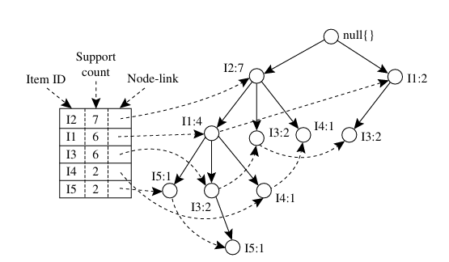
TID | List of items
T100 | I1, I2, I5
T200 | I2, I4
T300 | I2, I3
T400 | I1, I2, I4
T500 | I1, I3
T600 | I2, I3
T700 | I1, I3
T800 | I1, I2, I3, I5
T900 | I1, I2, I3

Slide 18
Conditional Pattern Base
The conditional pattern base is the path in the tree ending at the given frequent item. We first consider I5, which is the last item in L, rather than the first. I5 occurs in two FP-tree branches of Figure.
Null{}
I2:5
I2:6
I2:2
Item | Conditional Base Pattern
I1:2
I1:1
I5 {{I2,I1:1),{I2,I1,I3:1}}
I1:2
I4 {{I2,I1:1},{I2:1}}
Item Id | Support Count | Node-Link
I2 | 7
I1 | 6
I3 | 6
I4 | 2
I5 | 2
I1:3
I3 {{I2,I1:2},{I2:2},{I1:2}}
I4:1
I3:2
I3:2
I3:1
I1 {{I2:4}}
I5:1
I2 N/A
I4:1
I3:1
I5:1

Slide 19
Conditional FP Tree
Now for each item, we will build a conditional frequent pattern tree. It is computed by identifying the set of elements common in all the paths in the conditional pattern base of a given frequent item and computing its support count by summing the support counts of all the paths in the conditional pattern base. The conditional frequent pattern tree will look like this as shown below table:
Item | Conditional Base Pattern | Conditional FP Tree
I5 | {{I2,I1:1),{I2,I1,I3:1}}
I4 | {{I2,I1:1},{I2:1}}
I3 | {{I2,I1:2},{I2:2},{I1:2}}
I1 | {{I2:4}}
( I2:2, I1:2 )
( I2:2)
(I2:4,I1:2),(I1:2)
(I2:4)

Slide 20
Frequent itemsets
From the above conditional FP tree, we will generate the frequent itemsets as shown in the below table:
Item | Conditional Base Pattern | Conditional FP Tree | Frequent Patterns Generated
I5 | {{I2,I1:1),{I2,I1,I3:1}} | ( I2:2, I1:2 )
I4 | {{I2,I1:1},{I2:1}} | ( I2:2)
I3 | {{I2,I1:2},{I2:2},{I1:2}} | (I2:4,I1:2),(I1:2)
I1 | {{I2:4}} | (I2:4)
(I2,I5:2),(I1,I5:2),(I2,I1,I5:2)
(I2,I4:2)
(I2,I3:4),(I1,I3:4),(I1,I2,I3:2)
(I2,I1:4)

